Slide 1


MATLAB & Simulink workshop
Made by: Youssef Ahmed

Slide 2

Session 6
Introduction to Simulink

Slide 3

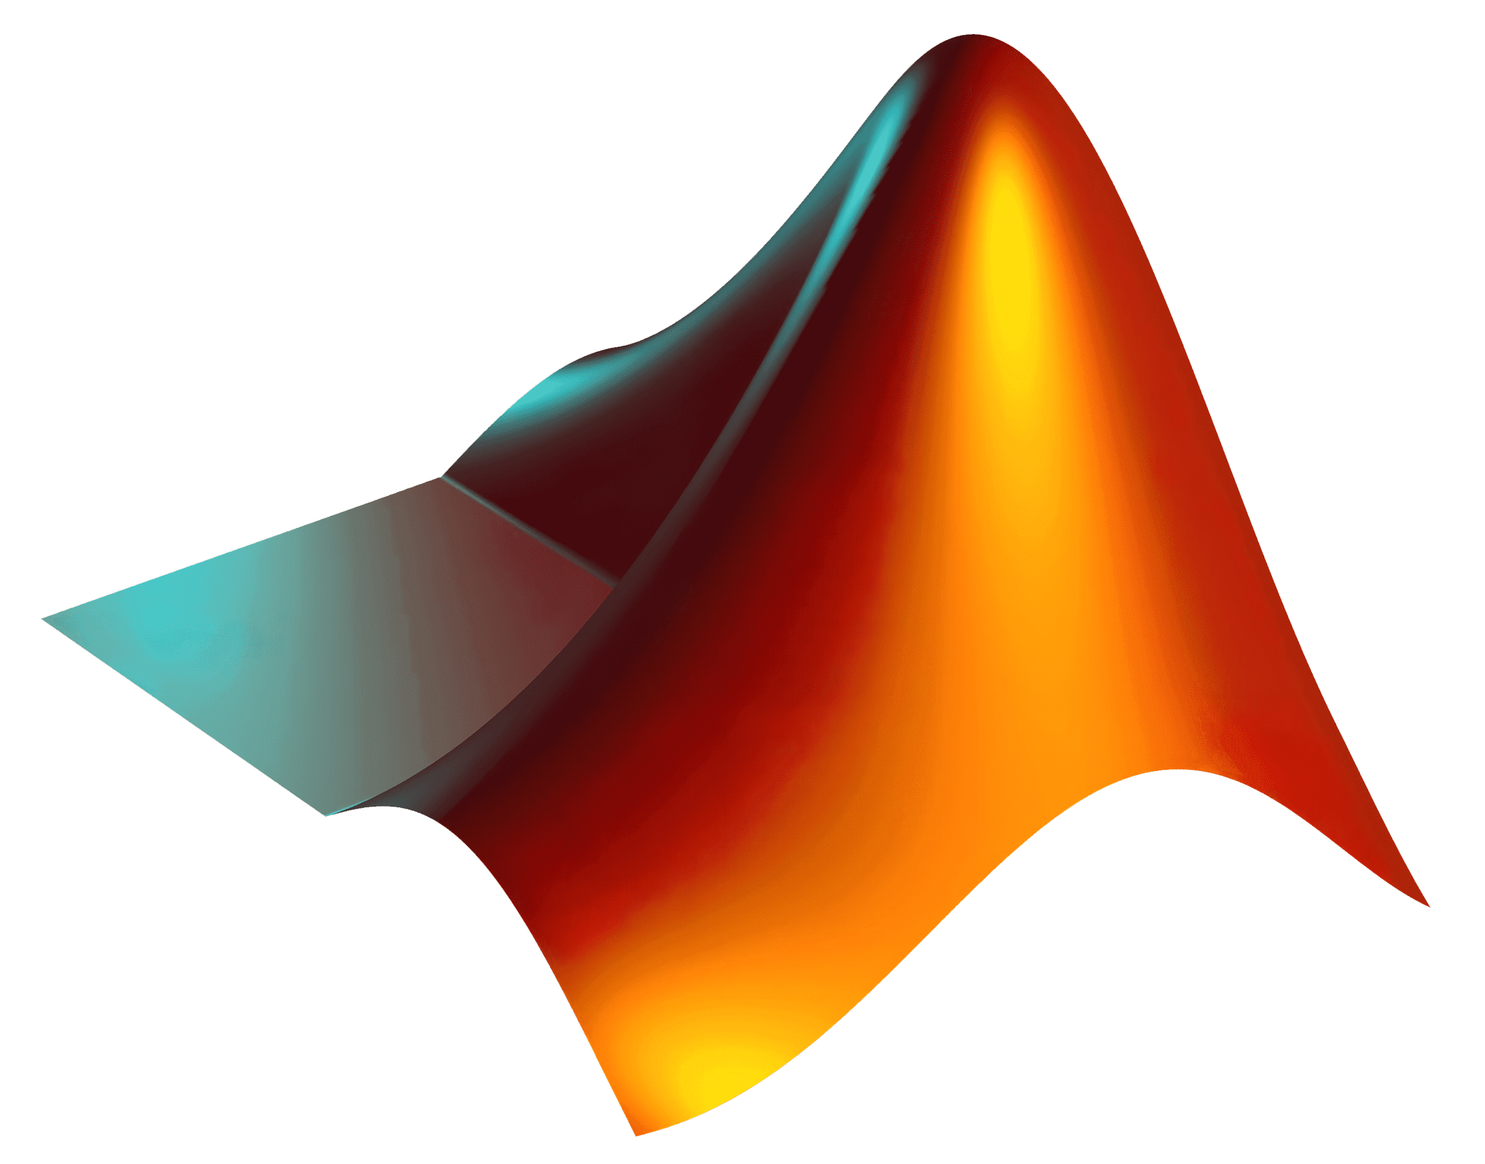
Simulink
Simulink Vs MATLAB
VS

Slide 4
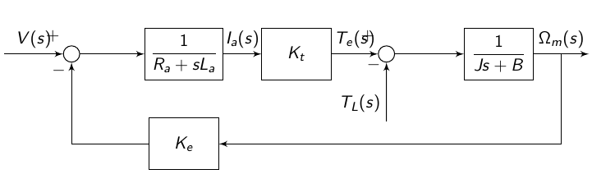
Simulink
Basics of block diagram

Slide 5
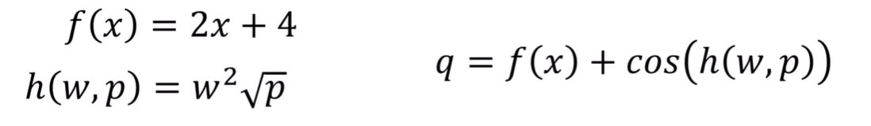
Simulink
Basics of block diagram
Example

Slide 6
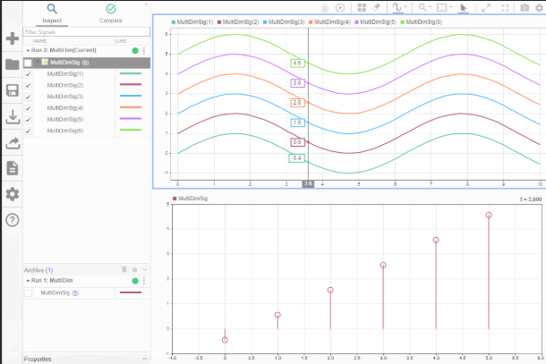
Simulink
Signals visualizations

Slide 7
Simulink
Commonly used blocks
We can categorize common blocks into:
Sources
Sinks
Mathematical operation
Dynamic & ODE building blocks
Control flow
Signals routing
Special blocks (to/from workspace, MATLAB function)

Slide 8
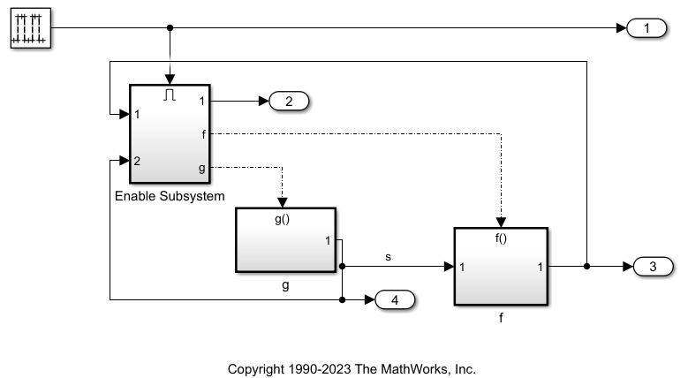
Simulink
Subsystems and abstraction

Slide 9
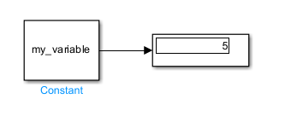
Simulink
Working with variables and workspace

Slide 10
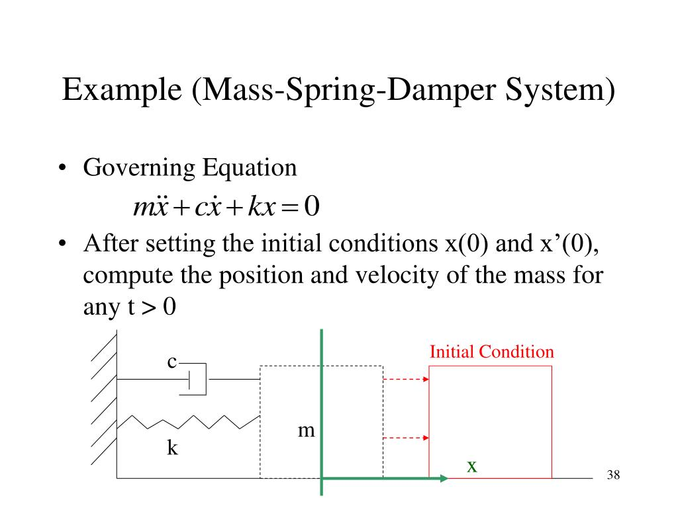
Simulink
Modeling of ODEs

Slide 11
Thank you!

